Slide 1
Software Process Models
Instructor: Mehroze Khan

Slide 2
What is Agile ?
An iterative approach to project management that helps teams be responsive and deliver value to their customers faster.

Slide 3
Key Characteristics of Agile Development
Adaptive Planning
Evolutionary Development
Early Delivery
Continual Improvement
Responsiveness to change

Slide 4
The Manifesto for Agile Software Development
Agile manifesto
Concentrate on responding to change rather than on creating a plan and then following it.
Value individuals and interactions over process and tools
Prefer to invest time in producing working software rather than in producing comprehensive documentation
Focus on customer collaboration rather than contract negotiation

Slide 5
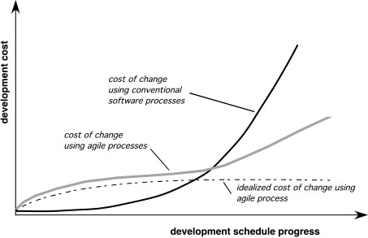
Agility and the Cost of Change

Slide 6
Human Factors
Key traits must exist among the people on an agile team and the team itself:
Competence.
Common focus.
Collaboration.
Decision-making ability.
Fuzzy problem-solving ability.
Mutual trust and respect.
Self-organization.

Slide 7
Extreme Programming (XP)
The most widely used agile process, originally proposed by Kent Beck
XP Planning
Begins with the creation of “user stories”
Each user story is written by the customer and is placed on an index card. The customer assigns a value (a priority) to the story based on the overall business value of the feature or function.
Agile team assesses each story and assigns a cost (measured in development weeks)
Stories are grouped to form a deliverable increment
A commitment is made on delivery date
After the first increment “project velocity” (number of customer stories implemented during the first release) is used to help define subsequent delivery dates for other increments
Notes:
Once a basic commitment (agreement on stories to be included, delivery date, and other project matters) is made for a release, the XP team orders the stories that will be developed in one of three ways:
all stories will be implemented immediately (within a few weeks)
the stories with highest value will be moved up in the schedule and implemented first
the riskiest stories will be moved up in the schedule and implemented first.

Slide 8
Extreme Programming (XP)
XP Design
Follows the Keep It Simple (KIS) principle. The design of extra functionality (because the developer assumes it will be required later) is discouraged
Encourage the use of CRC cards. CRC (class-responsibility collaborator) cards; identify and organize the object-oriented classes that are relevant to the current software increment.
For difficult design problems, suggests the creation of “spike solutions”—a design prototype.
Refactoring—modifying/optimizing the code in a way that does not change the external behavior of the software

Slide 9
Extreme Programming (XP)
XP Coding
Recommends the construction of unit tests for each user story before coding commences.
Once the unit test has been created, the developer is better able to focus on what must be implemented to pass the test.
Encourages “pair programming”; two people work together at one computer workstation to create code for a story. Provides a mechanism for real-time problem solving and real-time quality assurance.
Continuous Integration: As pair programmers complete their work, the code they develop is integrated with the work of others to uncover compatibility and interfacing errors.

Slide 10
Extreme Programming (XP)
XP Testing
Unit tests are executed repeatedly
XP acceptance tests, also called customer tests, are specified by the customer and focus on overall system features and functionality that are visible and reviewable by the customer.

Slide 11
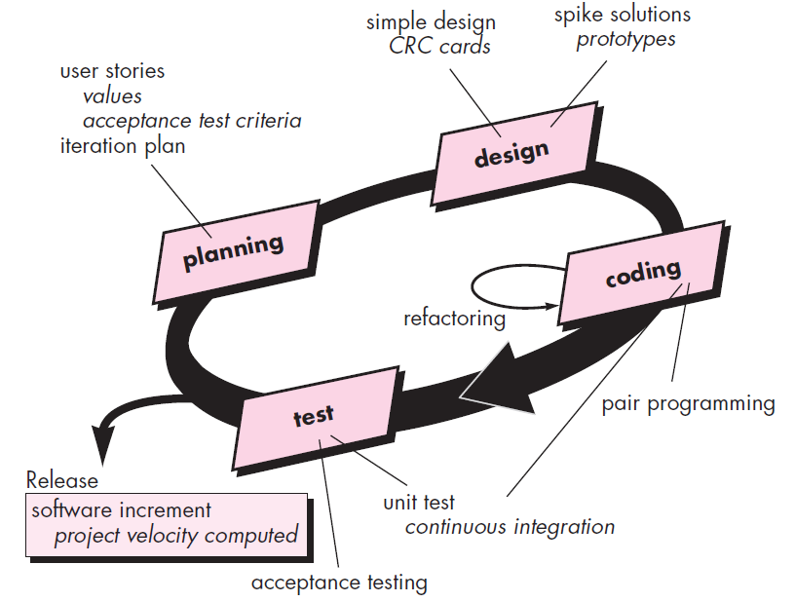
Extreme Programming (XP)

Slide 12
Scrum
Scrum (the name is derived from an activity that occurs during a rugby match)
Conceived by Jeff Sutherland and his development team in the early 1990s
It is a management framework for incremental product development.
Prescribes small, cross functional, self organizing teams.
Provides a structure of roles, meetings, rules and artifacts.
Uses fixed length iterations called sprints.
Has a goal to build a potentially shippable product increment with every iteration.

Slide 13
Sprint
A sprint is one iteration through design, code, test and deploy cycle.
Every sprint should have a goal.
Sprints are usually 2 to 4 weeks in duration.

Slide 14
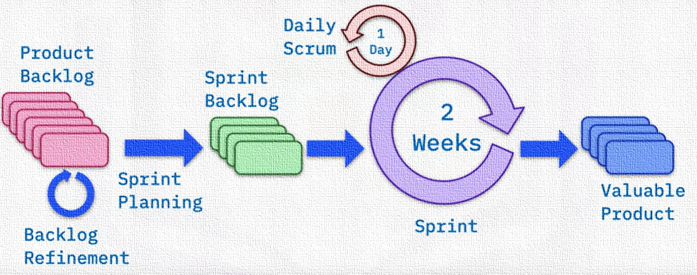
Scrum

Slide 15
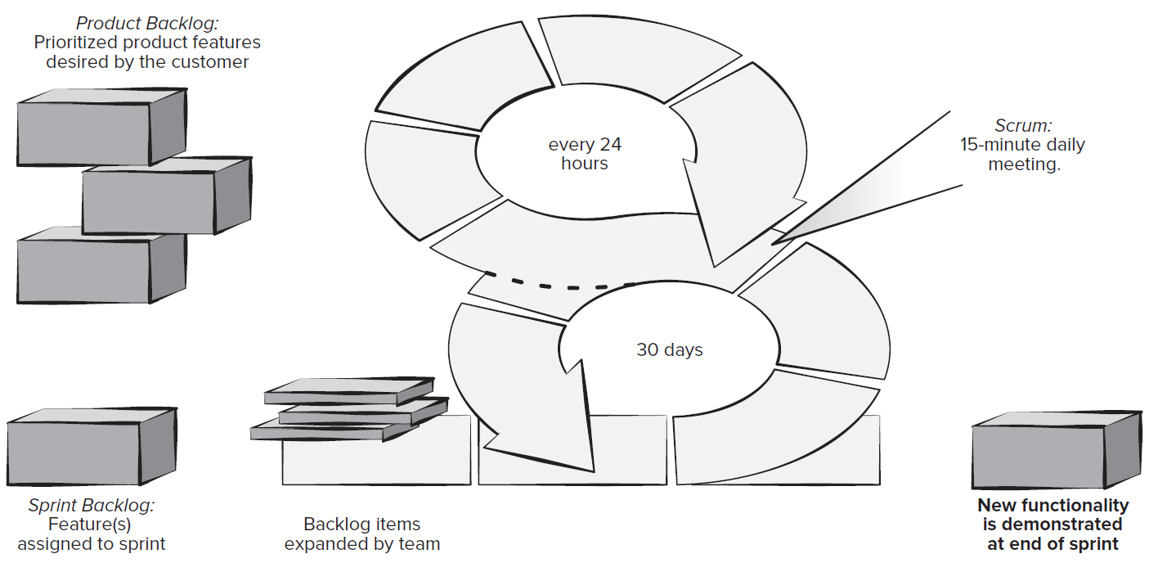
Scrum

Slide 16
Scrum Team
The Scrum team is a self-organizing interdisciplinary team consisting of a:
Product Owner
Scrum Master
Development Team (small 3 to 6 people)

Slide 17
Product Owner
Represents the stakeholder interests.
Articulates the product vision.
Is the final arbiter of requirements questions.
Constantly re-prioritizes the product backlog, adjusting any expectations.
Accepts or rejects each product increment.
Decides whether to ship.
Decides whether to end a sprint prematurely or extend the sprint if the increment is not accepted.

Slide 18
Scrum Master
Facilitates the scrum process.
Coaches the team.
Creates an environment to allow the team to be self organizing.
Shields the team from external interference to keep it “in the zone”.
Helps remove obstacles identified by team members during the meeting.
Enforces sprint timeboxes.

Slide 19
Development Team
It is a cross-functional team consisting of:
Developers
Testers
Business Analysts
Domain Experts
Others

Slide 20
Development Team
Self Organizing
There are no externally assigned roles.
Self Managing
They self assign their own work
Negotiates commitments with the product owner
One sprint at a time
Decides when the increment is done and ready to demonstrate to the product owner.

Slide 21
Scrum Artifacts
The principal Scrum artifacts are:
Product Backlog
Sprint Backlog
Code Increment

Slide 22
Scrum Artifacts
Product Backlog:
The product backlog is a prioritized list of product requirements or features that provide business value for the customer.
Sprint Backlog:
The sprint backlog is the subset of product backlog items selected by the product team to be completed as the code increment during the current active sprint.
Notes:
Items can be added to the backlog at any time with the approval of the product owner and the consent of the development team.
No new features can be added to the sprint backlog unless the sprint is cancelled and restarted.

Slide 23
Scrum Artifacts
Code Increment:
The increment is the union of all product backlog items completed in previous sprints and all backlog items to be completed in the current sprints.

Slide 24
Scrum Events
Sprint Planning Meeting
Daily Scrum Meeting (Daily Stand-up)
Sprint Review
Sprint Retrospective

Slide 25
Sprint Planning Meeting
Prior to beginning, development team works with the product owner and all other stakeholders to develop the items in the product backlog.
The product owner and the development team rank the items in the product backlog by the importance of the owner’s business needs and the complexity of the software engineering tasks required to complete each of them.
Prior to starting each sprint, the product owner states development goal for the increment to be completed in the upcoming sprint.
The Scrum master and the development team select the items to move from product backlog to the sprint backlog.
The development team determines what can be delivered in the increment within the constraints of the time-box allocated for the sprint and, with the Scrum master, what work will be needed to deliver the increment.

Slide 26
Daily Scrum Meeting
The daily Scrum meeting is a 15-minute event scheduled at the start of each workday to allow team members to synchronize their activities and make plans for the next 24 hours.
Three key questions are asked and answered by all team members:
What did you do since the last team meeting ?
What obstacles are you encountering ?
What do you plan to accomplish by the next team meeting ?

Slide 27
Sprint Review Meeting
The sprint review occurs at the end of the sprint when the development team has judged the increment complete.
The sprint review is often time-boxed as a 4-hour meeting for a 4-week sprint.
The Scrum master, the development team, the product owner, and selected stakeholders attend this review.
The primary activity is a demo of the software increment completed during the sprint.
The product owner may accept the increment as complete or not.

Slide 28
Sprint Retrospective
Ideally, before beginning another sprint planning meeting, the Scrum master will schedule a 3-hour meeting (for a 4-week sprint) with the development team called a sprint retrospective.
During this meeting, the team discusses:
What went well in the sprint ?
What could be improved ?
What the team will commit to improving in the next sprint ?

Slide 29
Project/Sprint Velocity
By looking at the amount of work the team has completed in previous sprints, you should be able to estimate how much work they can do in future sprints.
In Agile development, this estimate is known as sprint velocity.
Sprint velocity estimate gives senior management and other stakeholders a better idea of when to expect delivery of the product.

Slide 30
Calculating Project Velocity
To estimate what work can be completed in the future, you need to measure the work that has previously been done.
To get a good average measurement of work that has been done, plan to review the previous three sprints.
Story points are used to measure the amount of work completed in each sprint.
A story point is a measurement used by Agile development teams to estimate how much effort and time it will take to complete a user story.

Slide 31
Calculating Project Velocity
Step 1: Count how many user story points are completed in each sprint
At the end of a sprint, add up how many story points the team completed.
For example, assume that in sprint 1:
The team committed to completing five user stories.
Each user story had eight story points for a total of 40 story points.
The team completed three of the five user stories.
In sprint 2:
The team committed to seven user stories (including the two that were not completed in sprint 1).
Each user story had eight story points for a total of 56 story points.
The team completed four of the seven user stories.

Slide 32
Calculating Project Velocity
In sprint 3:
The team committed to nine user stories.
Each user story had eight story points for a total of 72 story points.
The team completed five of the nine user stories.

Slide 33
Calculating Project Velocity
Step 2: Calculate the average of completed story points
Simply add up the total of story points completed from each sprint, then divide by the number of sprints.
Sprint 1: 3 user stories x 8 story points = 24 Sprint 2: 4 user stories x 8 story points = 32 Sprint 3: 5 user stories x 8 story points = 40 Total = 96 story points
So, your average sprint velocity is 96 ÷ 3 = 32.
You can now base the amount of work to be done in future sprints on the average of 32 story points.
If you have 160 story points remaining to be completed in the project, you can assume that your team will need another five sprints to complete the project.

Slide 34
Kanban
Kanban originated in Toyota in the 1940s. Kanban’s meaning in Japanese is “visual card”.
Kanban is a very popular framework for development in the agile software development methodology.
It provides a transparent way of visualizing the tasks and work capacity of a team.
It mainly uses physical and digital boards to allow the team members to visualize the current state of the project they are working on.
The Kanban board has columns and story cards.
The columns are nothing, but workflow states and cards are nothing but a demonstration of the actual task a team member is performing.

Slide 35
Kanban Card
The Kanban cards are essential pieces on the Kanban board as it represents the work that the team is working on. These cards will have
Priority
Owner
Type
Due date

Slide 36
Work In Progress Limit(WIP Limit)
A column in Kanban board represents the work stage, and you can place a WIP (Work in Progress) limit on the column.
The WIP limit means the maximum number of cards that can stay on that column.
Since Kanban project management uses a pull-based system, as and when a developer is free, he/she can pull a card from the to-do column to the dev column.

Slide 37
Kanban Board
It is a physical or digital (JIRA) board designed to help teams visualize their work at different stages and processes.
It also helps represent the stages of work with columns using cards.
It has columns that represent the status of the work like
To-do,
Dev
Testing
Done.

Slide 38
Pull Based System
Kanban is a pull-based method where tasks are being pulled rather being pushed. As soon as you have completed your current card, you can pull a new card from the previous column of the Kanban board.

Slide 39
Kanban
Lead Time: It is the duration between a new card’s arrival in your workflow and its final departure from the workflow.
Cycle Time: It is a duration between the card’s arrival in the working state and when the card is ready for release.
WIP: Work in progress (WIP) limits the maximum amount of work items in the different stages of the workflow.
Throughput: It is the actual performance, and it tells the actual number of cards delivered in each timeframe.
Throughput = WIP/Cycle Time

Slide 40
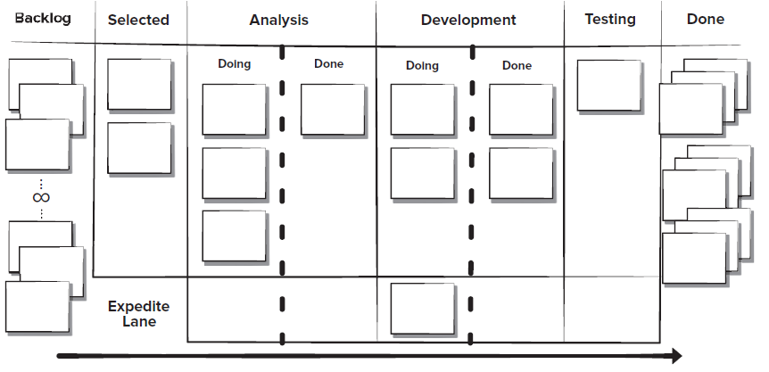
Kanban Board

Slide 41
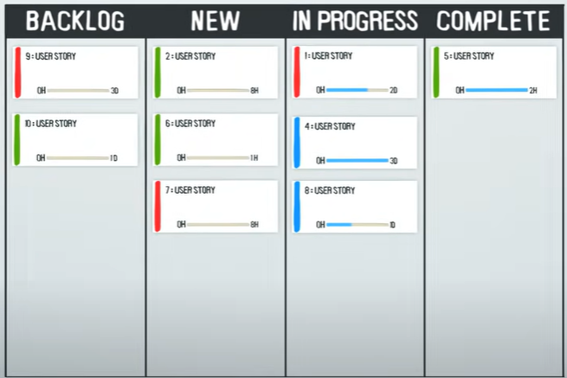
Kanban Board

Slide 42
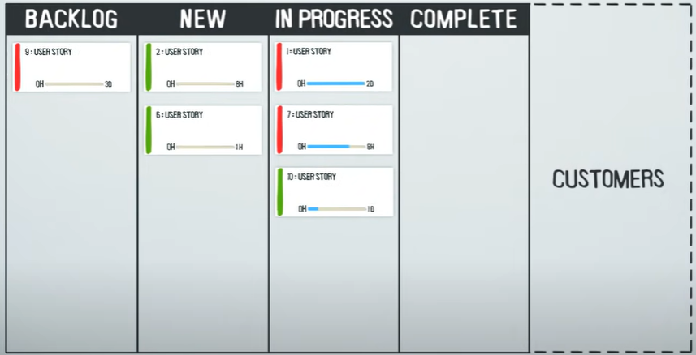
Kanban Board

Slide 43
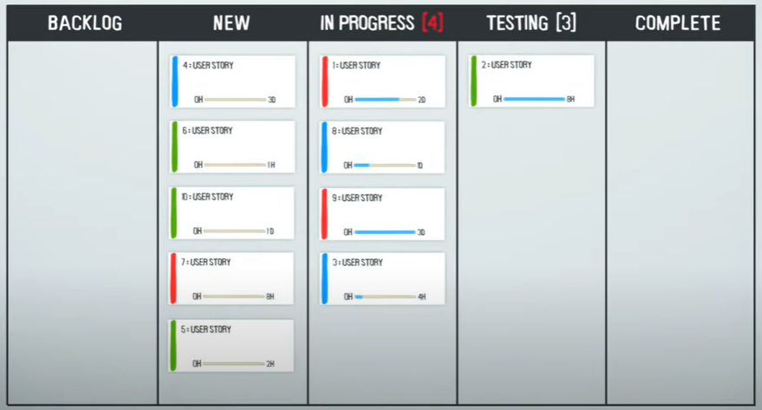
Kanban Board

Slide 44
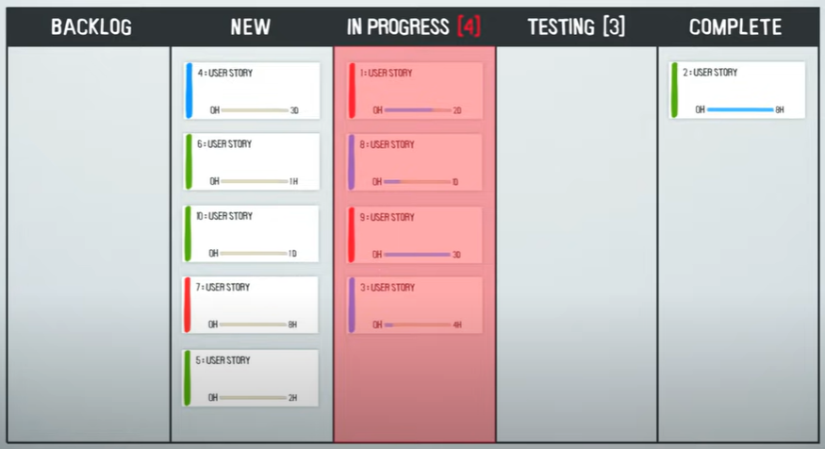
Kanban Board

Slide 45
Learn to use Kanban Boards on Jira
Popular Tools:
Trello
Jira
Asana
Microsoft Planner
https://www.youtube.com/watch?v=1tcAayUiSJI&ab_channel=CareersTalk

Slide 46
References
Shari PFleeger, Joanne Atlee, Software Engineering: Theory and Practice, 4th Edition
Roger S. Pressman, Software Engineering A Practitioner’s Approach, 9th Edition. McGrawHill

